Slide 1


Basic Details of the Team and Problem Statement
Ministry/Organization Name/Student Innovation:
AICTE, MIC-Student Innovation
PS Code: SIH1493
Problem Statement Title: Student Innovation
Team Name: Komet
Team Leader Name: Abhijit Patil
Institute Code (AISHE): U-0760
Institute Name: Indian Institute of Information Technology, Sri City, Chittoor
Theme Name: Heritage & Culture

Slide 2
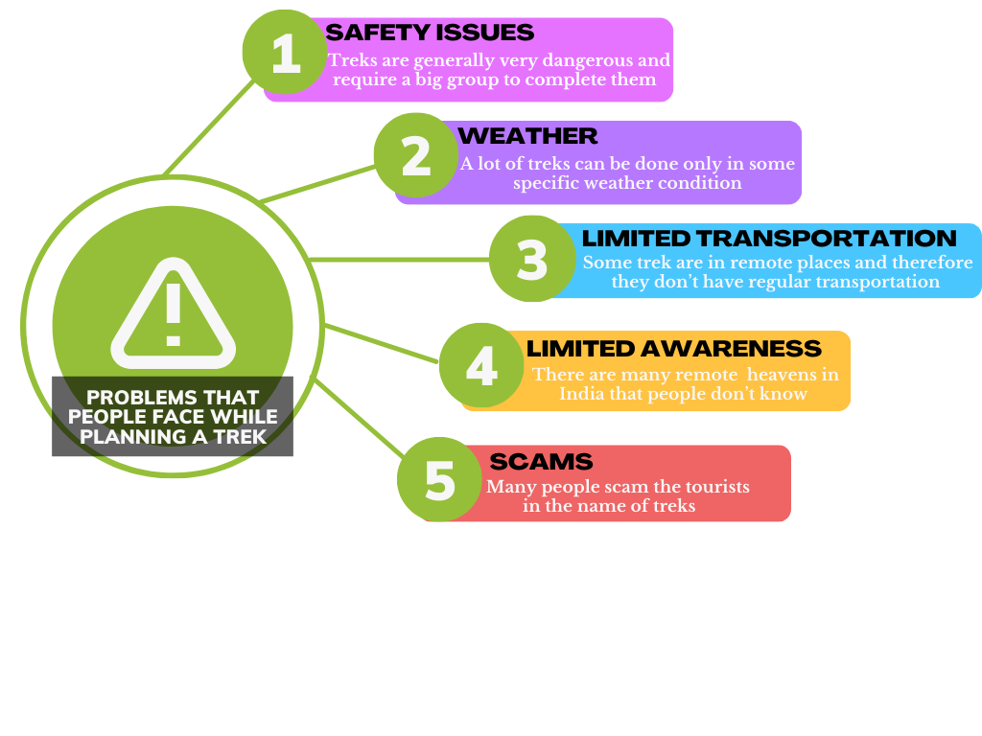

-- APPROACH --
• India is a very diverse country with a very rich heritage and culture
• But now-a-days due to globalization and foreign influence many Indians have forgotten their roots
• The key objective of this project is to put this incredible diversity and heritage to good use and help other fellow Indians benefit from it.
• A times of India study published in march 2019 says that almost 80% of all small-scale gathering in India are organised in malls or restaurant and we want to change that.
• But to change this first we will need to find out the reason behind why do people prefer malls and restaurants over treks to waterfalls or forts
Describe your Technology stack here:

Slide 3
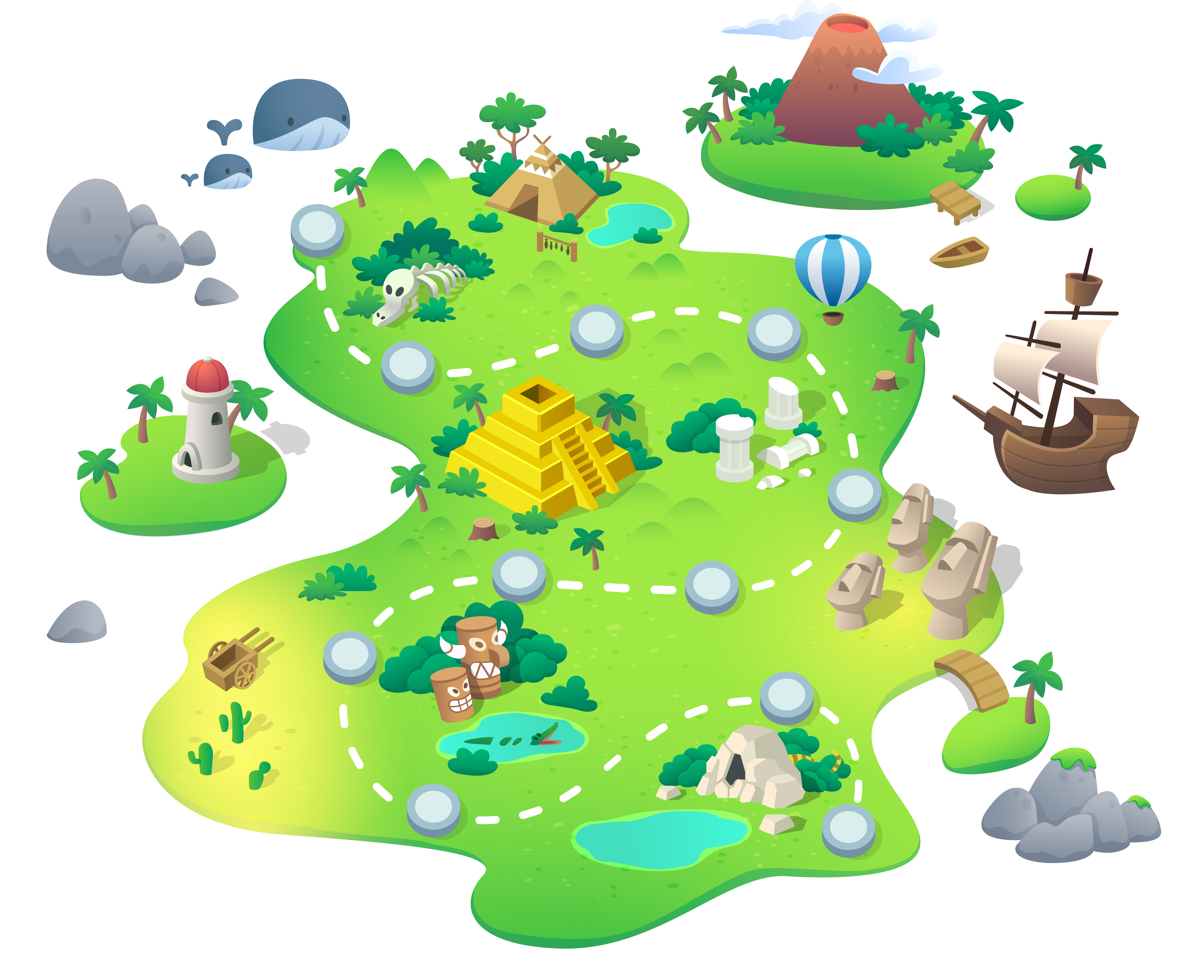

Slide 4
Team Member Details
Team Leader Name: Abhijit Patil
Branch : Btech Stream : ECE Year : I
Team Member 1 Name: Gaurav Gautam
Branch : Btech Stream: CSE Year : I
Team Member 2 Name: Vyom Nikhra
Branch : Btech Stream: AI&DS Year : I
Team Member 3 Name: Vedant Kesarwani
Branch : Btech Stream :CSE Year: I
Team Member 4 Name: Abhiraj Singh Chauhan
Branch : Btech Stream : CSE Year : I
Team Member 5 Name: Mallepaga Sarayu
Branch : Btech Stream : CSE Year : I
Team Mentor 1 Name: Type Your Name Here
Category (Academic/Industry): Expertise (AI/ML/Blockchain etc): Domain Experience (in years):
Team Mentor 2 Name: Type Your Name Here
Category (Academic/Industry): Expertise (AI/ML/Blockchain etc): Domain Experience (in years):

